Slide 2
Developing with Brightcove Player
Matt Boles, Learning Specialist
mboles@brightcove.co or training@brightcove.com

Slide 3
Introducing the Course

Slide 4
What: Brightcove Player
The Brightcove Player is based on the Video.js Player
Three core elements:
Video embed code - Places a video into a website using the HTML5 <video> element falling back to Flash automatically
JavaScript library - Makes the player work across browsers, their various versions and around device / platform bugs
Pure HTML/CSS skin - Creates a uniform look across HTML5 browsers and easy custom skinning for a branded look

Slide 5
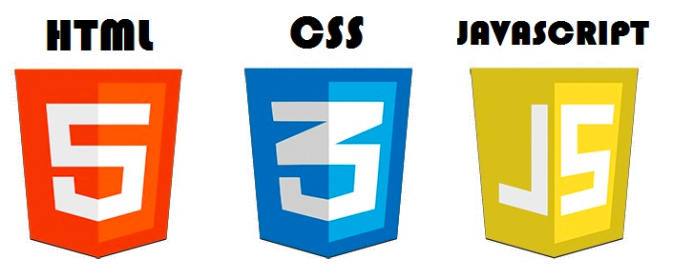
What: Brightcove Player Development
Used to customize, integrate with, or add functionality to, your players
Uses HTML5, CSS, JavaScript and the Player API
Cross-platform standards
Developer-friendly technologies

Slide 6
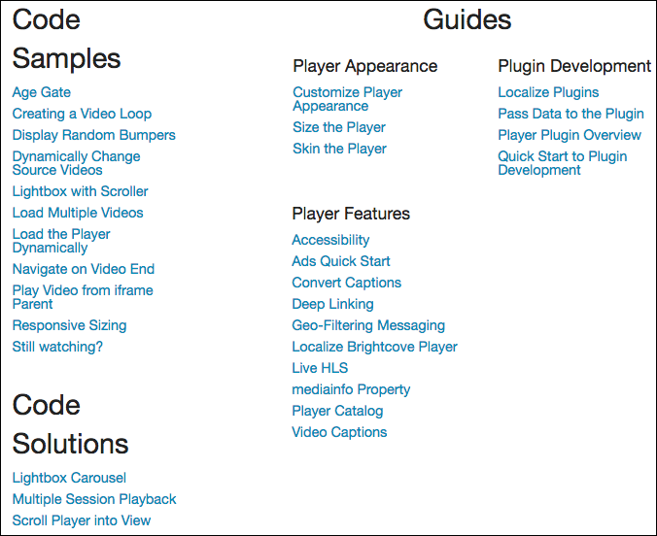
Why: Code Samples and Solutions
http://docs.brightcove.com/en/video-cloud/brightcove-player/index.html

Slide 7
How: Agenda
Introducing the Course
Setting Up to Develop with Brightcove Player
Using JavaScript with Brightcove Player
Getting Started with Brightcove Player Development
Demo 1: Using the API to Play a Video
Using the Player Catalog
Demo 2: Dynamically Loading and Playing a Video
Using the mediainfo Property
Demo 3: Display Video Information in the HTML Page
Using the iframe Player Implementation
Demo 4: Changing the Video in an iframe Player Implementation

Slide 8
How: Agenda (cont)
Using the iframe Player Implementation
Demo 4: Changing the Video in an iframe Player Implementation
Adding a Brightcove Plugin to a Player
Demo 5: Adding the Overlay Plugin to a Player
Demo 6: Using the IMA Plugin to Play VAST Ads
Customizing Player Appearance
Demo 7: Use CSS to Customize Big Play Button
Creating and Using a Plugin
Demo 8: Creating an Overlay Plugin and Adding it to a Player

Slide 9
Prerequisites
The session is designed for developers with basic HTML and JavaScript experience

Slide 10
Setting Up to Develop with Brightcove Player

Slide 11
Setup
Video Cloud Account
You will also need an editor for HTML/JavaScript
Any plain text editor will work
An editor such as Chocolat, Sublime Text, Dreamweaver, BBEdit, or CoffeeCup, that provides code-hinting and syntax highlighting is recommended
For iframe player implementation examples a web server is needed
XAMPP and WAMP free options

Slide 12
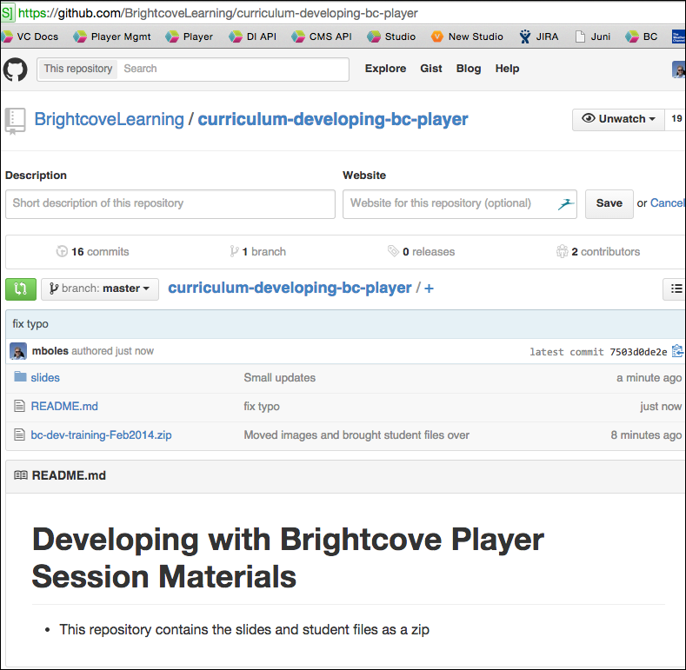
Getting Session Materials - GitHub
Student files and slides
https://github.com/BrightcoveLearning/curriculum-developing-bc-player
http://bit.ly/1EDWaCA

Slide 13
Brightcove Player API Documentation
Consists of the Video.js API PLUS Brightcove Player additions
Cumulative doc here:
http://docs.brightcove.com/en/video-cloud/brightcove-player/reference/api/index.html
Focus in this session on methods and events (vjs.player):
http://docs.brightcove.com/en/video-cloud/brightcove-player/reference/api/vjs.Player.html

Slide 14
Using JavaScript with Brightcove Player

Slide 15
JavaScript Code Dilemma
Purpose of this session is to teach Smart Player API code
Decided it is not appropriate to suggest too many best practices in JavaScript
Good pattern to use is a basic version of the Module pattern
Keeps variables out of the global name space to avoid collisions with other scripts used in the page
All variable initialized at the top to make it easier to find them
Allows you to have both public and private data/functions
Used in numerous document solutions

Slide 16
API Is Event Driven
function foo() {
player = this;
player.loadVideo(123);
player.play();
}
videojs("video").ready(function(){
var myPlayer = this;
});
otherComponent.on("play", function(){
//Video is playing
});

Slide 17
Callback Function Implementations
Anonymous Function
videoPlayer.getCurrentVideo(function(videoDTO) {
document.getElementById("displayName").
innerHTML = videoDTO.displayName;
});
OR
Function Expression / Declaration
videoPlayer.getCurrentVideo(onGetVideo);
var onGetVideo = function(videoDTO) {
document.getElementById("displayName").
innerHTML = videoDTO.displayName;
};

Slide 18
Getting Started with Brightcove Player Development

Slide 19
Get Reference to Player
Create a <script> block
Use the ready method
Create variable that holds reference to the player instance
videojs("myPlayerID").ready(function(){
var myPlayer = this;
});
**Do not have to use ready if you are certain Flash fallback never used; best practices is to always use

Slide 20
Player Methods
Docs: http://docs.brightcove.com/en/video-cloud/brightcove-player/reference/api/vjs.Player.html
Method example
myPlayer.play();

Slide 21
Player Events
Docs: http://docs.brightcove.com/en/video-cloud/brightcove-player/reference/api/vjs.Player.html
Use on() and off() methods to add and remove event listeners
Event example
myPlayer.on("timeupdate", showUpdate);

Slide 22
Demo 1: Using the API to Play a Video and Display Event Object

Slide 23
Using the Player Catalog

Slide 24
Player Catalog
Player Catalog is a helper library for making requests to the Video Cloud catalog
The catalog makes it easy to get information on Video Cloud media and loads them into a player
Currently two methods
myPlayer.catalog.getVideo(videoID,callback)
myPlayer.catalog.load(videoObject)

Slide 25
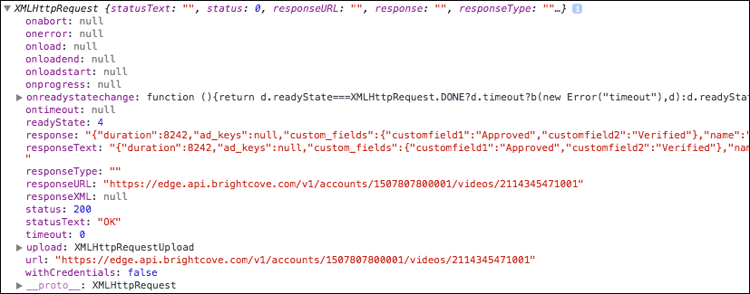
Returned Object from getVideo()
Catalog returns an object of type XMLHttpRequest

Slide 26
Demo 2: Dynamically Loading and Playing a Video

Slide 27
Using the mediainfo Property

Slide 28
mediainfo Property
The mediainfo property is an object which contains information on the current media in the player
The property is created and populated when using the load() method from Brightcove Player's catalog object
After the mediainfo object is populated, use it for convenient data retrieval when wishing to display video information, like the video name or description

Slide 29
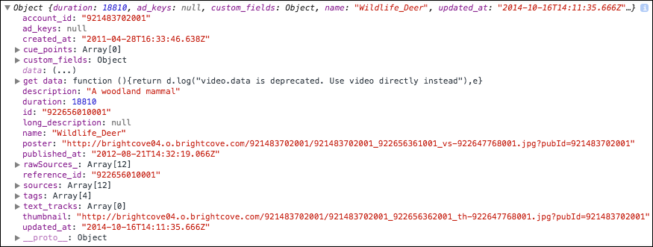
Data in mediainfo

Slide 30
Access mediainfo Data
Access the data in the mediainfo object by simple object.property notation
dynamicHTML = "<p>Video Title: <strong>" + myPlayer.mediainfo.name + "</strong></p>";
dynamicHTML += "<p>Description: <strong>" + myPlayer.mediainfo.description + "</strong></p>";
document.getElementById("textTarget").innerHTML = dynamicHTML;

Slide 31
Demo 3: Display Video Information in the HTML Page

Slide 32
Using the iframe Player Implementation

Slide 33
Advantages of iframe Player Implementation
No collisions with existing JavaScript and/or CSS
Automatically responsive (nearly)
The iframe eases use in social media apps (or whenever the video will need to "travel" into other apps)
Simple localization

Slide 34
When You Cannot Use iframe Implementation
Code in the containing page needs to listen for and act on player events
The player uses styles from the containing page
The iframe will cause app logic to fail, like a redirect from the containing page

Slide 35
Dynamically Change Video in iframe
To dynamically change video in an iframe add a query string to the src property
<iframe src='//players.brightcove.net/…index.html' …> </iframe>
var iframeTag=document.getElementsByTagName("iframe")[0],
newVideo = "?videoId=922656010001";
function changeVideo() {
iframeTag.src += newVideo;
}

Slide 36
Communicate Between HTML Page and iframe
It is possible to communicate between the parent page and the iframe
Uses HTML postMessage
Example doc: Play Video from iframe Parent
http://docs.brightcove.com/en/video-cloud/brightcove-player/samples/listen-for-play-button.html

Slide 37
Demo 4: Changing the Video in an iframe Player Implementation

Slide 38
Adding a Brightcove Plugin to a Player

Slide 39
Plugins for Brightcove Player
A plugin for the Brightcove player uses a combination of HTML, JavaScript and/or CSS to somehow customize the player
In other words, anything you can do in a web page, you can do in a plugin
Broadly, plugins can be developed to
Modify default behavior
Add functionality
Customize appearance

Slide 40
Brightcove Supplied Plugins
Brightcove has released, and continues to release, plugins
Debugger
Display Thumbnail Previews
Errors
Google Analytics
HLS
IMA
OnceUX
Overlay
Social Media

Slide 41
Brightcove Plugins Loaded by Default
The following are plugins loaded by default
Debugger
Errors
HLS

Slide 42
Implementing Plugins Using Studio UI
One of three ways to use a plugin
Use the Studio UI to supply the plugin's
JavaScript
Name
Options (if needed)
CSS (if needed)
Plugin associated with ALL instances of the player

Slide 43
Implementing Plugins Using Custom Code
Second way use a plugin
Use a <script> tag to manually include the plugin's JavaScript
Use a <link> tag to manually include the plugin's CSS (if needed)
Call the plugin as a method, supplying required options
myPlayer.ima3({
serverUrl: "http://pubads.g.doubleclick.net/…"
});
Plugin associated ONLY with the instance of the player on the page
Provides flexibility, such as dynamically supplying options

Slide 44
Implementing Plugins Using curl Statements
Can configure the player, and associated plugins, using the Player Management API
Details on using curl not part of this course
curl --header "Content-Type: application/json" --user $EMAIL --request PATCH \
--data '{
"stylesheets": ["http://…/plugin-dev.css"
],
"scripts": ["http://…/plugin-dev.js"
],
"plugins": [{ "name": "pluginDev", "options": {"overlayText": "This …"}
}]
}' \
https://players.api.brightcove.com/v1/accounts/$ACCOUNT_ID/players /$PLAYER_ID/configuration

Slide 45
Demo 5: Adding the Overlay Plugin to a Player AND/OR Demo 6: Using the IMA Plugin to Play VAST Ads

Slide 46
Customizing Player Appearance

Slide 47
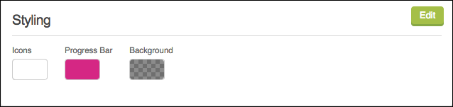
Customization Approaches
Very limited options in Studio UI
Manual customization with CSS

Slide 48
Steps for Customization of Player Appearance
Decide what you would like to change
Determine appropriate CSS selector for the element you wish to change
Create and apply the CSS

Slide 49
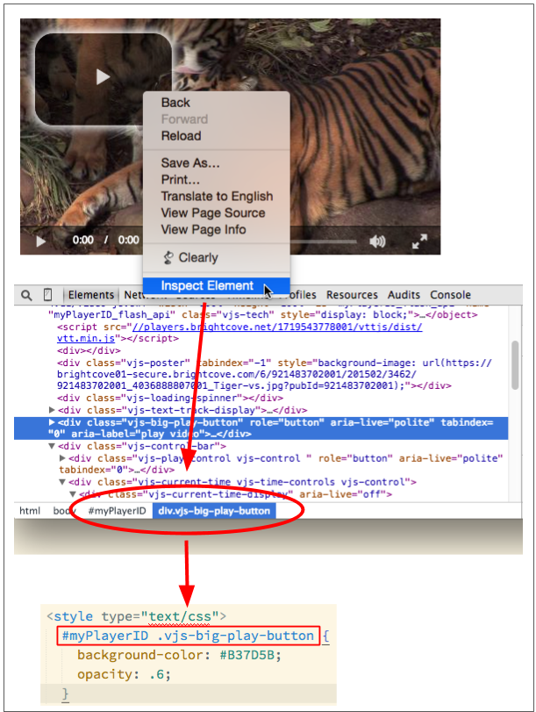
Determine Element Selector – Example 1
In Chrome, right-click on play button
Inspect element
Look at "path" in Development Tools
Translate into style

Slide 50
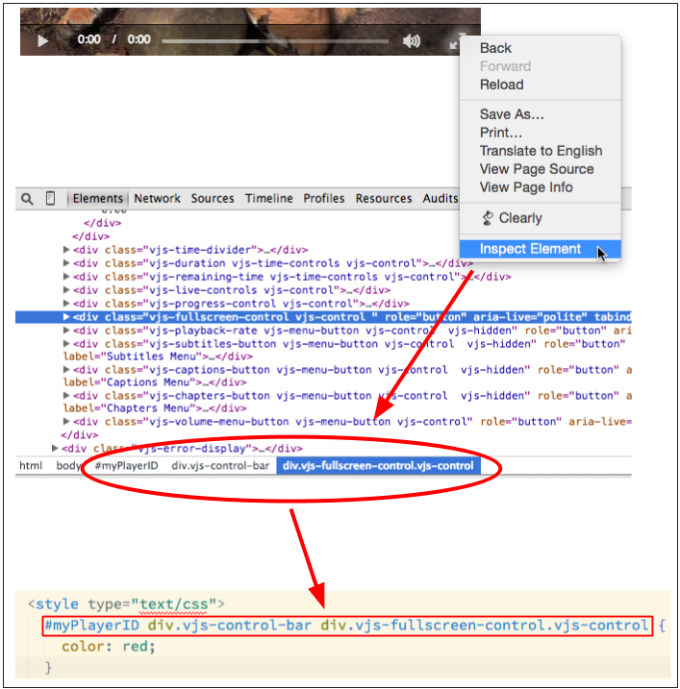
Determine Element Selector – Example 2
In Chrome, right-click on fullscreen button
Inspect element
Look at "path" in Development Tools
Translate into style

Slide 51
Demo 7: Customizing the Big Play Button with CSS

Slide 52
Creating and Using a Plugin

Slide 53
Process for Creating and Using a Custom Plugin
Create the JavaScript for the plugin in a separate file
Create the CSS for the plugin in a separate file (if needed)
Add the CSS and JavaScript to your HTML page
From the player object, call the name of the plugin defined in the JavaScript
Create an options object, pass it to the plugin function definition and use (if needed)

Slide 54
Creating a Plugin with JavaScript
Brightcove Player plugins must follow a general format:
videojs.plugin('pluginName', function() {
var player = this;
//Any JavaScript, HTML and CSS
});
Can also pass options to the plugin

Slide 55
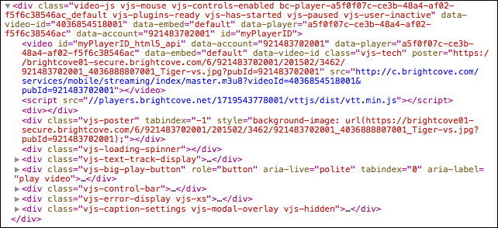
Used in Plugin: myPlayer.el() Method
Gets the player's DOM element (what the <video> tag is transformed into); HTML5 Version

Slide 56
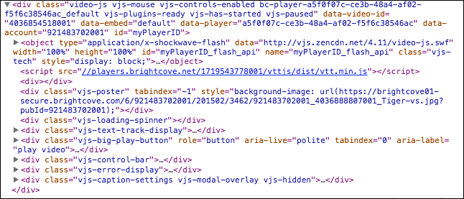
Used in Plugin: myPlayer.el() Method
Gets the player's DOM element (what the <video> tag is transformed into); Flash Version

Slide 57
JavaScript to Create Your Own Overlay
videojs.plugin('pluginDev', function() {
var player = this,
overlay = document.createElement('p');
overlay.className = 'vjs-overlay';
overlay.innerHTML = "Becoming a plugin expert";
player.el().appendChild(overlay);
});

Slide 58
CSS for Your Own Overlay
.vjs-overlay {
background-color: #333333;
color: white;
position: absolute;
}

Slide 59
Use Custom Plugin
<link href="demo7-plugin-solution.css" rel="stylesheet">
<script type="text/javascript" src="demo7-plugin-solution.js"></script>
<script type="text/javascript">
videojs('myPlayerID').ready(function(){
myPlayer = this;
this.pluginDev();
})
</script>

Slide 60
Demo 8: Creating an Overlay Plugin and Adding it to a Player (No Options)

Slide 61
Pass in Options to the Plugin
Create an options object that contains the desired data
Pass the object as a parameter to the plugin
Use the data in the plugin as desired using object.property notation
In HTML page
var options = {"overlayText": "Custom data"};
this.devName(options);
In plugin
videojs.plugin('devName', function(options) {..}
overlay.innerHTML = options.overlayText;

Slide 62
Demo 8: Creating an Overlay Plugin and Adding it to a Player (With Options)

Slide 63
Thank You!
Matt Boles
mboles@brightcove.com

